Slide 1
GSM Hacking and Cracking

Slide 2
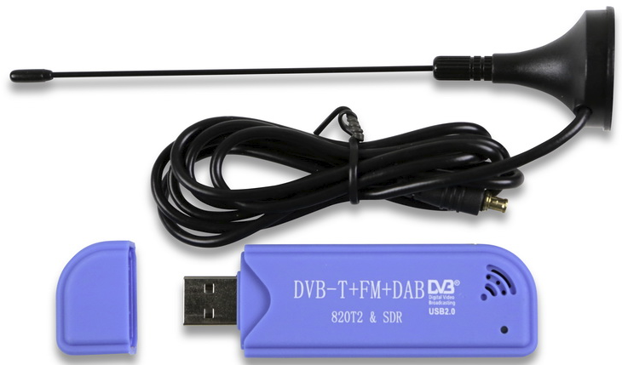
Why GSM Hacking
With the creation of Software-Defined-Radio, it is easier now than ever.
SDR is radio that is defined by software, not hardware. Antenna support wide ranges and software is created to decode protocol at frequencies that fall within the supported range of the antenna.
It’s pretty cool

Slide 3
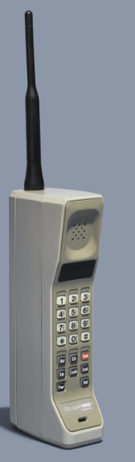
Cellular Technology through the Generations
1G – Introduced in the 1980s, Unsecured Analog, completely phased out.
AMPS (Advanced Mobile Phone System) was developed by Bell Labs in used in the Americas starting in 1983 at 850MHz. In 2008 FCC no longer required carriers to support it.
Data Speed – 2.4Kbps
https://github.com/unsynchronized/gr-amps allows you to create your own AMPS 1G network using a HackRF or USRP.

Slide 4
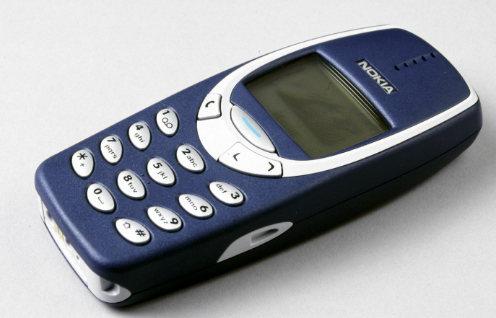
Cellular Technology through the Generations
2G – Started in 1991 with the launch of GSM (Global System for Mobile Communications). 2G was digitally encrypted, more spectrum efficient and had greater wireless penetration. Also the was introduction of SMS. GPRS technology was introduced, enabling web-browsing, email, and faster download speeds. This is know as 2.5G. EDGE (Enhanced Data Rates for GSM Evolution) enhanced GSM speeds up to 1 Mbit/s. This is 2.75G.
TDMA – Time Division Multiple Access
Data Speed – 50 Kbps

Slide 5
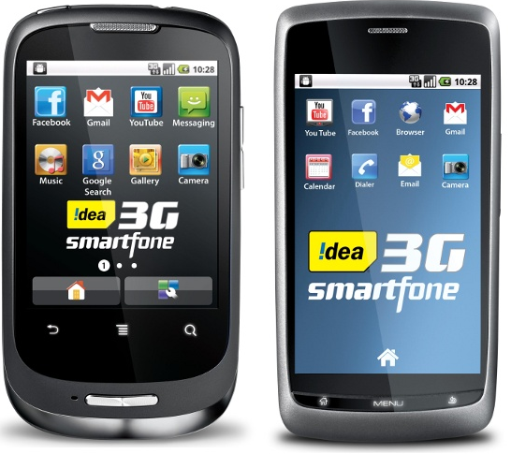
Cellular Technology through the Generations
3G – became popular in early 2000s.
UMTS – Universal Mobile Telecommunications Services, used in Japan, China, Europe and United States.
CDMA2000 – 2002, used in North America and South Korea
Wideband-Code-Division-Multiple-Access
Data Speed – 2Mbps
3G Was later enhanced with HSPA (H, High-Speed Packet Access) and HSPA+ (H+, Evolved High Speed Packet Access).

Slide 6
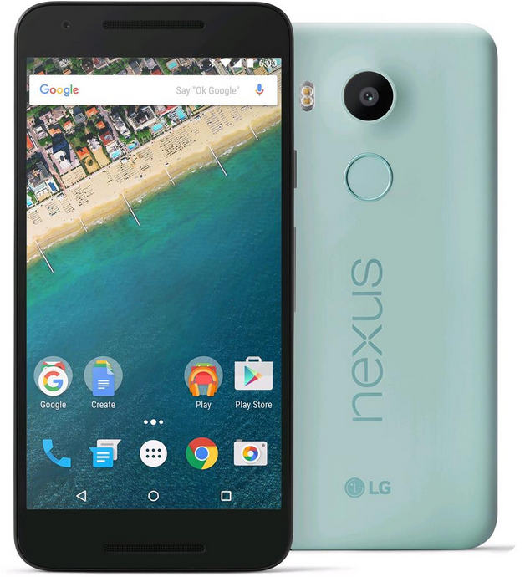
Cellular Technology through the Generations
4G – was first released in 2009 with the birth of LTE (Long Term Evolution).
MIMO – Multiple-In Multiple-Out and OFDMA – Orthogonal Frequency Division Multiple Access
Data Speed 20 -100 Mbps
4G+/LTE-A
Mobile WiMAX (IEEE 802.16m) is another 4G technology.

Slide 7
GSM In Depth - 4 Components
Mobile Station (ME (IMEI) + SIM (ISMI/TSMI))
Base Station Subsystem (BTS + BSC)
Network Switching Subsystem (MSC + HLR + VLR + AUC + EIR)
Operation Support System - Provides administration and operation, security management, network configuration and optimization, and maintenance of the GSM network.

Slide 8
GSM in depth – Mobile Station
The Mobile Station is the ME + SIM
ME – Mobile Equipment. This is the hardware used to connect to the GSM network that contains an IMEI (International Mobile Equipment Identity)
SIM – Subscriber Identity Module. Your SIM card.

Slide 9
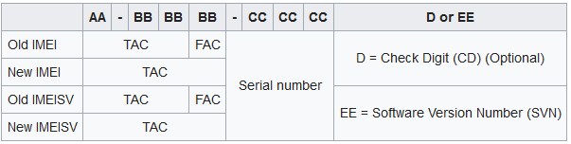
Unique Identification - IMEI
IMEI (International Mobile Equipment Identity) is how the physical mobile equipment is identified. It is a serial number burned into the phone by the manufacturer. GSM Networks use the IMEI number to identify valid devices, and will block cell phones from accessing the network if the IMEI is a part of the the Central Equipment Identity Register (EIR), a collection of blacklisted IMEIs. IMEIs are added to the blacklist when reported as stolen.
IMEI Structure:
Dial *#06# for your IMEI number.
TAC: Type Allocation Code – Identifies model of phone
FAC: Final Assembly Code – Manufacturer-specific code indicating location of the devices construction

Slide 10
SIM Cards
The SIM Card contains your subscription information specific to you. It also Includes:
IMSI – International Mobile Subscriber Identity
SPN – Service Provider Name
LAI – Local Area Identity (MCC + MNC + LAC/Location Area Code)
Ki
Phone number calls and receives, phone books, data, etc.
SIM cards can be transferred to other phones.

Slide 11
Unique Identification - IMSI
IMSI (International Mobile Subscriber Identity) is how the subscriber is identified on the network. It is burned into the SIM card when the subscription is registered.
ISMI Structure
123 99(9) 1234567890
MCC MNC MSIN
MCC – Mobile Country Code (The Country you are in)
MNC – Mobile Network Code (AT&T, T-Mobile, etc.)
MSIN – Mobile Subscriber Identification Number (Unique to each user)

Slide 12
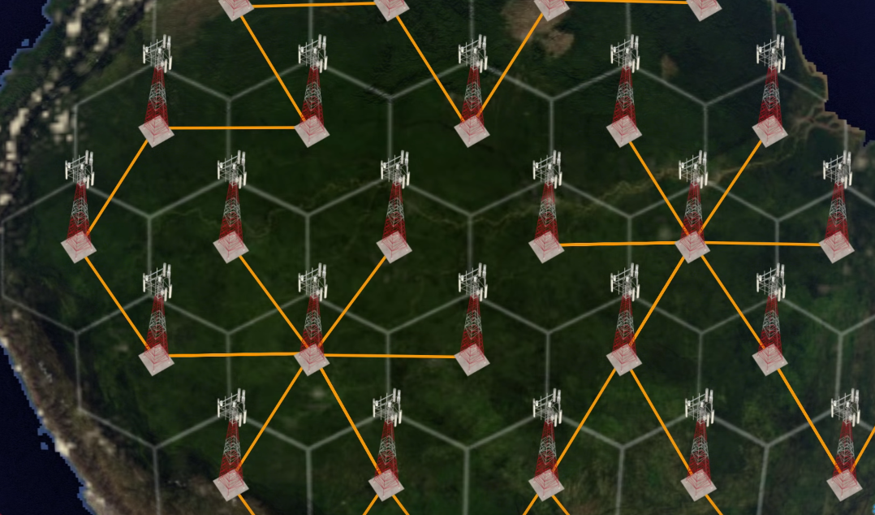
Base Station Subsystem
Your cell phone transmits wireless signals to a cell tower. Geographic areas are divided into hexagonal cells with a cell tower in it. The cell towers are then connect to each other via cable.
In GSM, Cell towers are known as Base Transceiver Stations (BTS). A Base Station Controller (BSC) controls multiple BTSs.

Slide 13
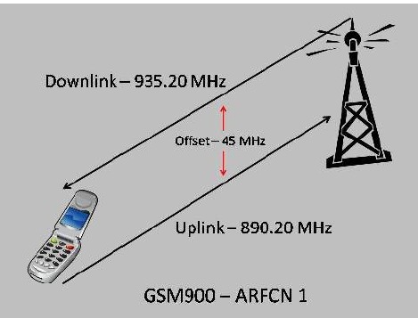
Base Station Subsytem - Communication
Uplink – When your cell communicates to the tower. Downlink – when the cell tower communicates to you. Both have a different frequency range and a specific offset.
ARFCN – Absolute Radio Frequency Channel Number – a code that specifies a pair of uplink and downlink frequencies for a user.
The BSC controls the allocation of radio frequencies.

Slide 14
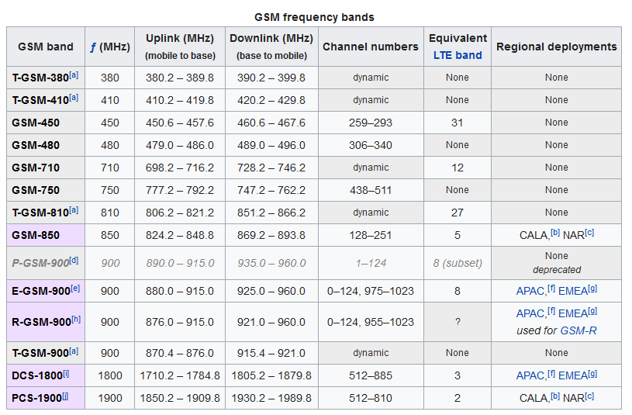

Slide 15
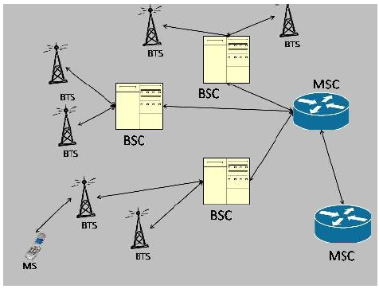
Network Switching Subsystem - MSC
The Mobile Switching Center (MSC) handles call routing, setup, and switching. The MSC handles multiple BSC (base station controllers).
The Gateway MSC (GMSC) is a gateway to route calls to outside of the GSM network.
The visited MSC is the MSC where a customer is currently located The Visitor Location Register (VLR) associated with this MSC will have the subscriber’s data in it.

Slide 16
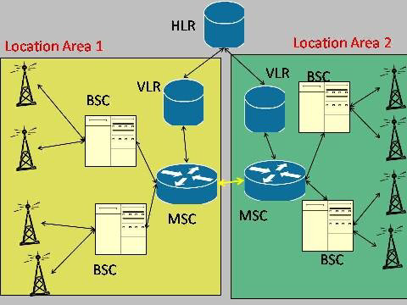
Network Switching Subsystem – HLR, VLR, LAC
The MSC communicates with the HLR – Home Location Register. It is a central database that stores all the subscription information from your SIM card, using your ISMI as the primary key to each HLR record. The main function of the HLR is to update the location of subscribers as they physically move to a new Location Area.
The Visitor Location Register (VLR) is a database that contains a similar information in the HLR, but only for subscribers in its Location Area. Every Location Area has a VLR. The VLR reduces network traffic and queries to the HLR. The VLR also assigns TMSIs (Temporary Mobile Subscriber Identity) to MS as it enters the LAC.
Each Location Area has a code now as a LAC – Location Area Code.
Roaming: You leave LAC 1 and enter LAC 2. You cell phone connects to a BTS in LAC 2. The ISMI in your SIM is used to identify you and the VLR does not recognize you. The VLR requests your subscription data from the HLR. The HRL looks up the HLR record associated to that ISMI. HLR sends subscription data to the VLR in LAC 2 and tells the VLR in LAC 1 to remove the data. The VLR then assigns you a TSMI to continue communication.

Slide 17
Network Switching Subsystem – EIR, AuC
The EIR (Equipment Identity Register) – database with blacklisted IMEIs.
AuC – Authentication Center – performs the authentication and encryption tasks for the network, and stores the Ki for each ISMI. It also generates the RAND, SRES and Kc cryptovariables.
RAND - The RAND is a random 128-bit number that is generated by the AuC when the network requests to authenticate a subscriber. The RAND is used to generate the Signed Response (SRES) and Kc cryptovariables.
Signed Response - The SRES is a 32-bit cryptovariable used in the authentication process. The MS is challenged by being given the RAND by the network, the SRES is the expected correct response. The SRES is never passed on the Um (Air) interface. It is kept at the MSC/VLR, which performs the authentication check.
Kc - The Kc is the 64-bit ciphering key that is used in the A5 encryption algorithm to encipher and decipher the data that is being transmitted on the Um interface.

Slide 18
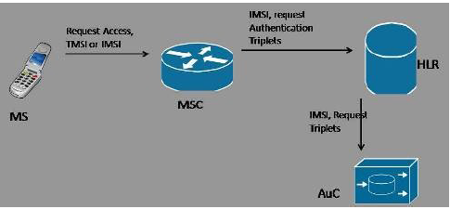
GSM Authentication and Encryption
Whenever a MS requests access to a network, the network must
authenticate the MS. Authentication verifies the identity and validity of the SIM card to
the network and ensures that the subscriber is authorized access to the network.
Ki - The Ki is the individual subscriber authentication key. It is a 128-bit number that is paired with an IMSI when the SIM card is created. The Ki is only stored on the SIM card and at the Authentication Center (AuC). The Ki should never be transmitted across the network on any link.
Triplets - The RAND, SRES, and Kc together are known as the Triplets. The AuC will send these three cryptovariables to the requesting MSC/VLR so it can authenticate and encipher.

Slide 19
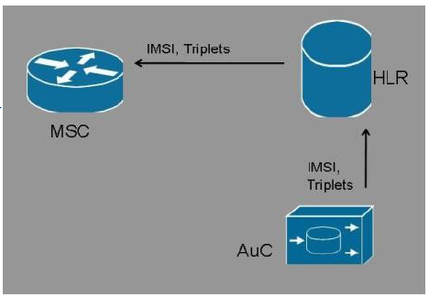
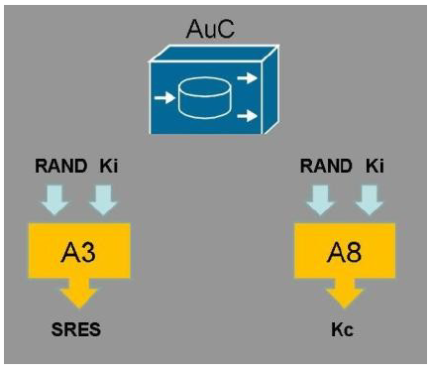
GSM Algorithms
A3 Algorithm - The A3 algorithm computes a 32-bit Signed Response (SRES). The Ki and RAND are inputted into the A3 algorithm and the result is the 32-bit SRES. The A3 algorithm resides on the SIM card and at the AuC.
A8 Algorithm - The A8 algorithm computes a 64-bit ciphering key (Kc). The Ki and the RAND are inputted into the A8 algorithm and the result is the 64-bit Kc. The A8 algorithm resides on the ISMI card and at the AuC.
A5 Algorithm - The A5 encryption algorithm is used to encipher and decipher the data that is being transmitted on the Um interface. The Kc and the plaintext data are inputted into the A5 algorithm and the output is enciphered data.

Slide 20
GSM A5 Algorithms
The A5 encryption algorithm is the most important to use because it is the one used to encrypt communicatons between the cell phone (ME) and cell tower (BTS). There are 4 different version of A5 algorithm:
A5/0 – No encryption – rarely used if ever
A5/1 – Used through Europe and the United States. Stream Cipher with 64 bits.
A5/2 – A deliberately weaken version of A5/1 used in non-western countries. In 2006 the GSM Associated mandated the GSM phones will no longer be requires to support A/52. Also a stream cipher.
A5/3 – Also known as KASUMI, it is a block cipher used in GSM, as well as GPRS and UMTS (3G).
The A5 encryption was initially secret, but leaked in 1994, and reverse engineered in 1999 by Marc Briceno.

Slide 21
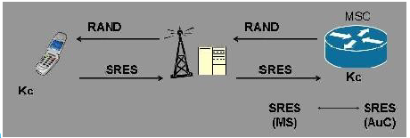
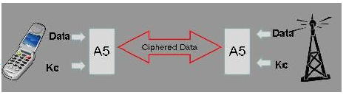
GSM Ciphering
The MS stores the Kc on the SIM card and sends the generated SRES back to the network. The MSC receives the MS generated SRES and compares it to the SRES generated by the AuC. if they match, then the MS is authenticated.
Once authenticated, the BTS sets the cipher mode to A/5X and encrypted communication can begin.

Slide 22
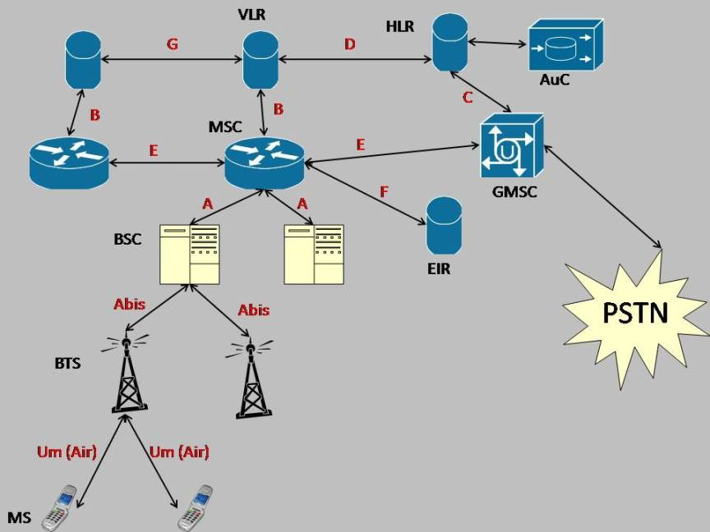
GSM in action

Slide 23
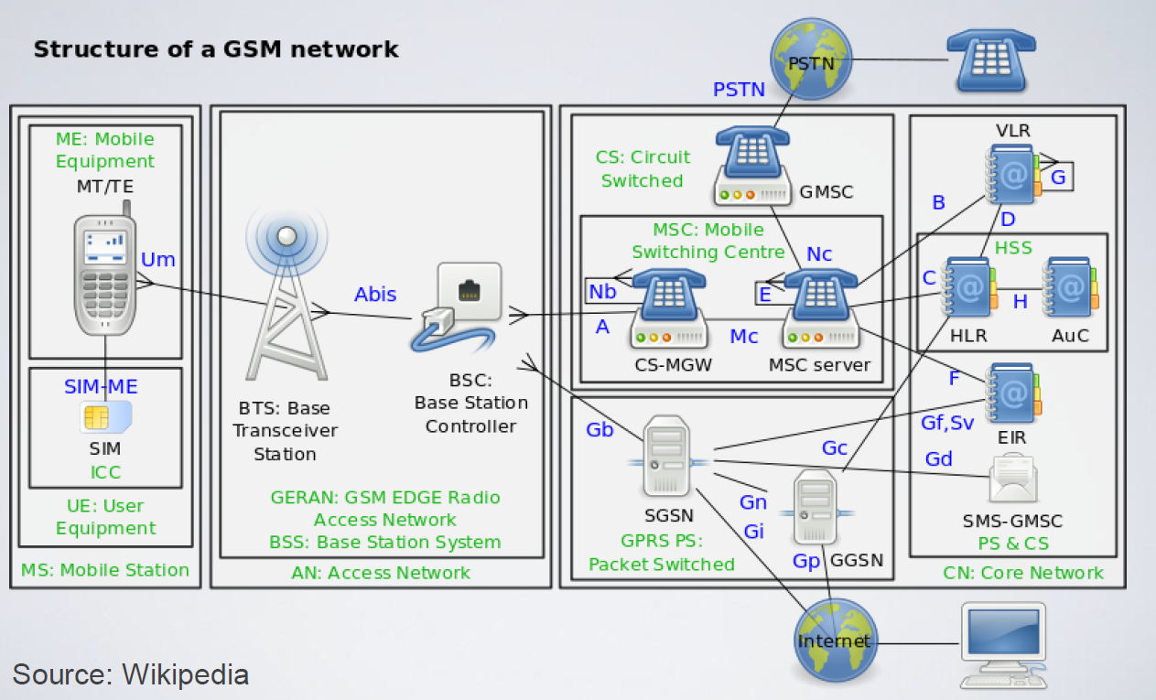

Slide 24
GSM InSecurity
The GSM circuit‐switched part does not protect the link between the base station and the BSC. In many cases microwave links are used, which are vulnerable to third party monitoring.
GSM allows man‐in‐the‐middle attacks with equipment that masquerades as a GSM base station.
The Kc length used in GSM is 64 bits. Although secure when GSM was first developed in the early 1990s, the length is considered insufficient today.
A number of weaknesses with the A5/1 stream cipher have been detected, allowing decryption

Slide 25
Available Attacks
There are multitude of attacks available to use against a GSM network besides decryption.
Ethics – Please be nice.

Slide 26
Cell Phone Attacks – Signal Jamming (1G, 2G, 3G, 4G)
Signal Jamming can be used against any generation of cellular communications, with cheap single-purpose jammers, or done through using a Software-Defined-Radio.
FCC – Fun Cannot Commence
https://www.fcc.gov/general/jammer-enforcement

Slide 27
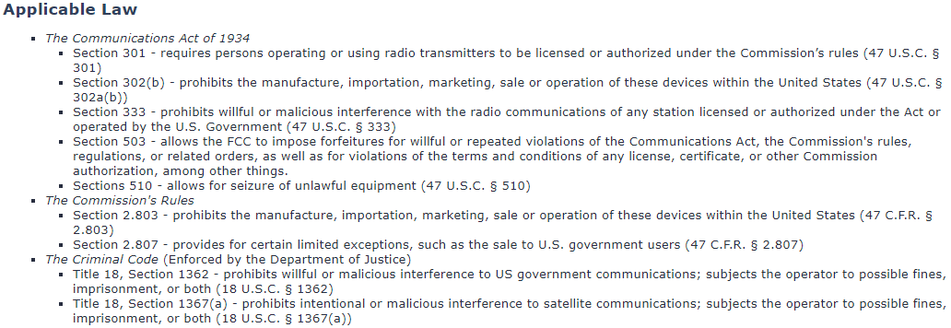
Cell Phone Attacks – Signal Jamming (1G, 2G, 3G, 4G)
https://www.fcc.gov/general/jammer-enforcement

Slide 28
Cell Phone Attacks – Unencrypted Eavesdropping (1G, 2G)
1G networks were analog and vulnerable to eavesdropping.
If a 2G GSM Base Transceiver Station is communicating using the A5/0 Algorithm, communication is not encrypted. A normal BTS would likely never use A5/0. However, a fake BTS station can be created with OpenBTS that requires ME to use A5/0. A fake LTE Station can be created with OpenLTE.

Slide 29
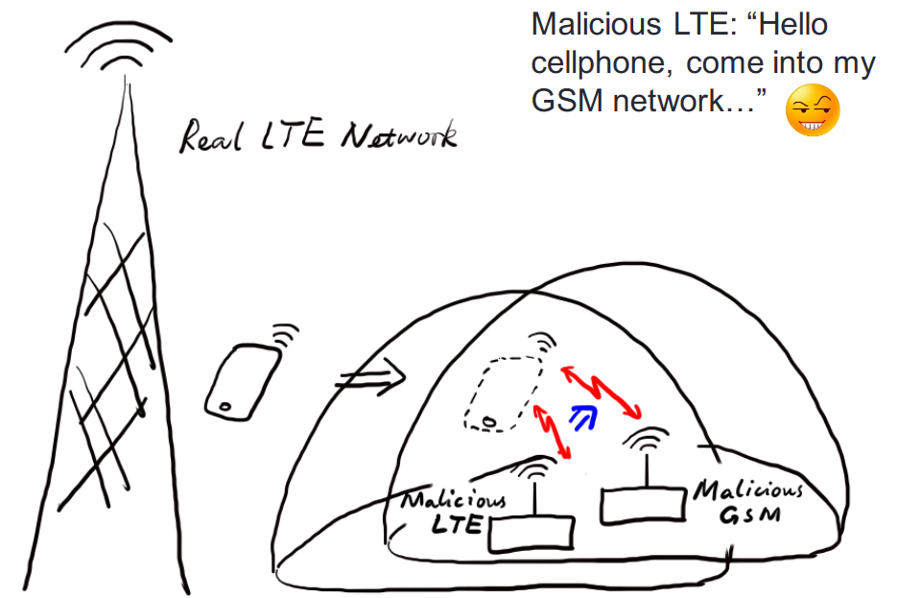
Cell Phone Attacks – Redirection Attack (4G/3G + 2G)
This is possible due to the Radio Resource Control, RCC, in unencrypted and can be spoofed. This occurs in LTE and UMTS networks.
DEF CON 24 - Haoqi Shan, Wanqiao Zhang - Forcing a Targeted LTE phone into Unsafe Network

Slide 30
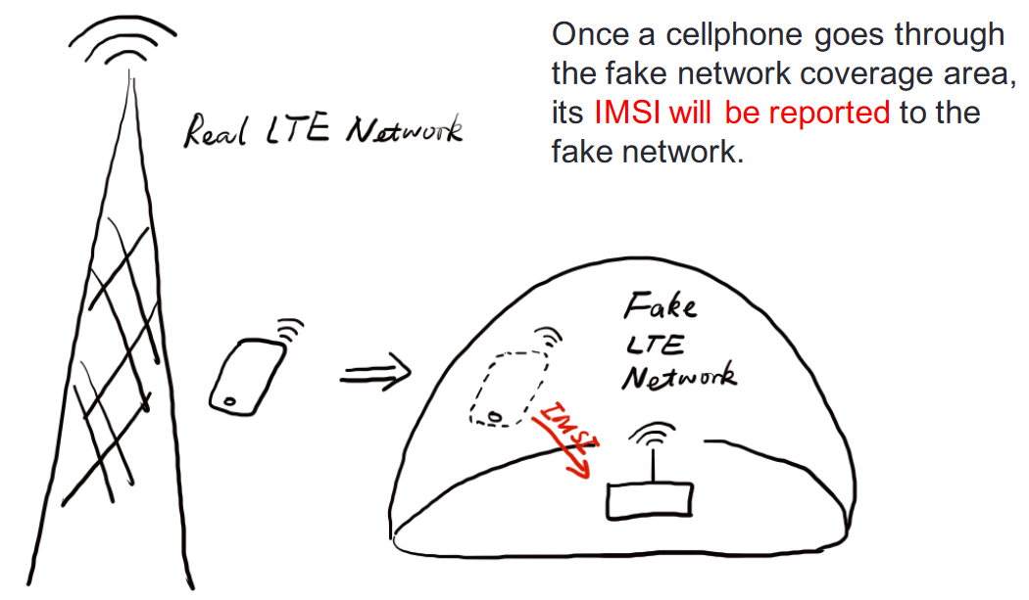
Cell Phone Attacks – IMSI Catcher (2G, 3G, 4G)
This is can be active or passive, we will show how to create a passive ISMI catcher with the RTL-SDR.
DEF CON 24 - Haoqi Shan, Wanqiao Zhang - Forcing a Targeted LTE phone into Unsafe Network

Slide 31
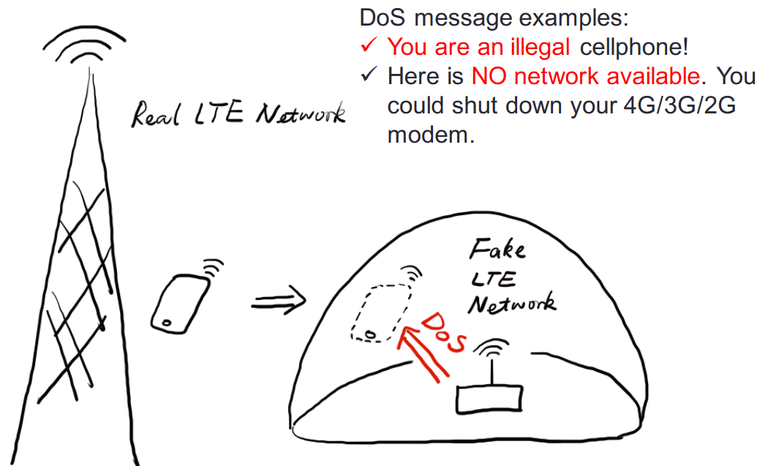
Cell Phone Attacks – DoS Attack (2G, 3G, 4G)
This is possible due to the Radio Resource Control, RCC, in unencrypted and can be spoofed. This occurs in LTE and UMTS networks. In GSM the Radio Link Control is used.
DEF CON 24 - Haoqi Shan, Wanqiao Zhang - Forcing a Targeted LTE phone into Unsafe Network

Slide 32
Lawful Interception
Law enforcement agencies with court orders or other legal authorization to selectively wiretap individual subscribers.
1968 Omnibus Crime Control and Safe Streets Act, Title III
1978 Foreign Intelligence Surveillance Act, Amended by PATRIOT ACT
1994 Communications Assistance for Law Enforcement Act (CALEA)
2001 PATRIOT ACT, Section 215 Allowed NSA to call connection metadata. (Section 215 was amended to stop the NSA's collection)

Slide 33
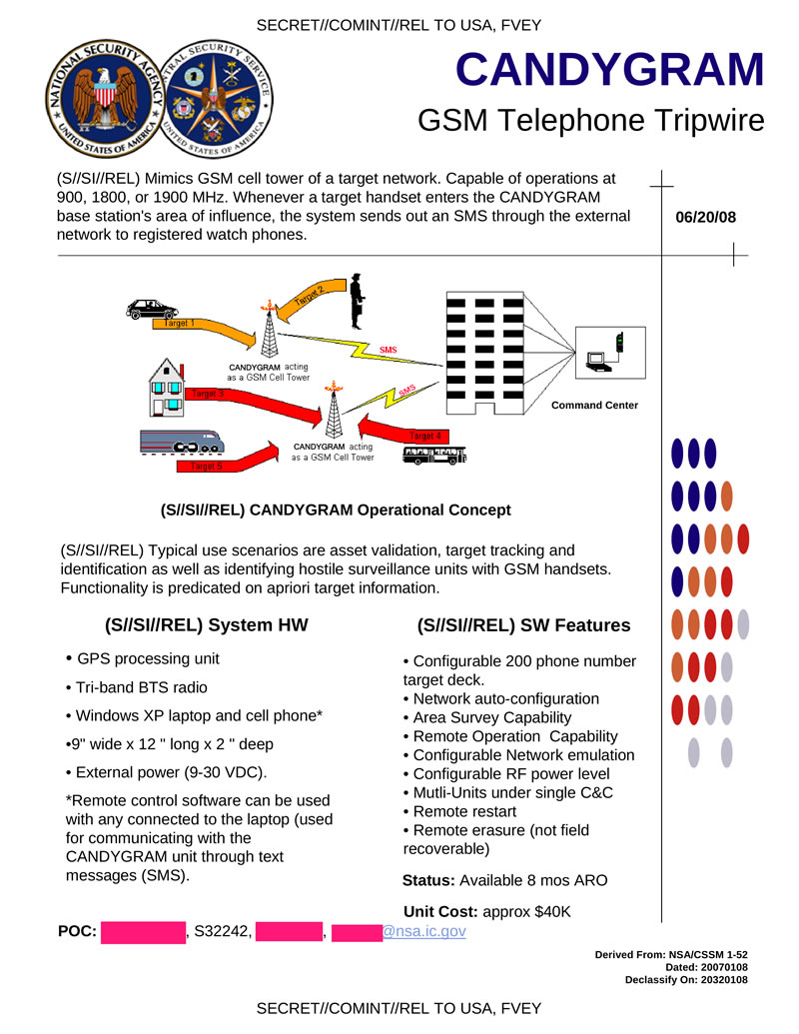

Slide 34
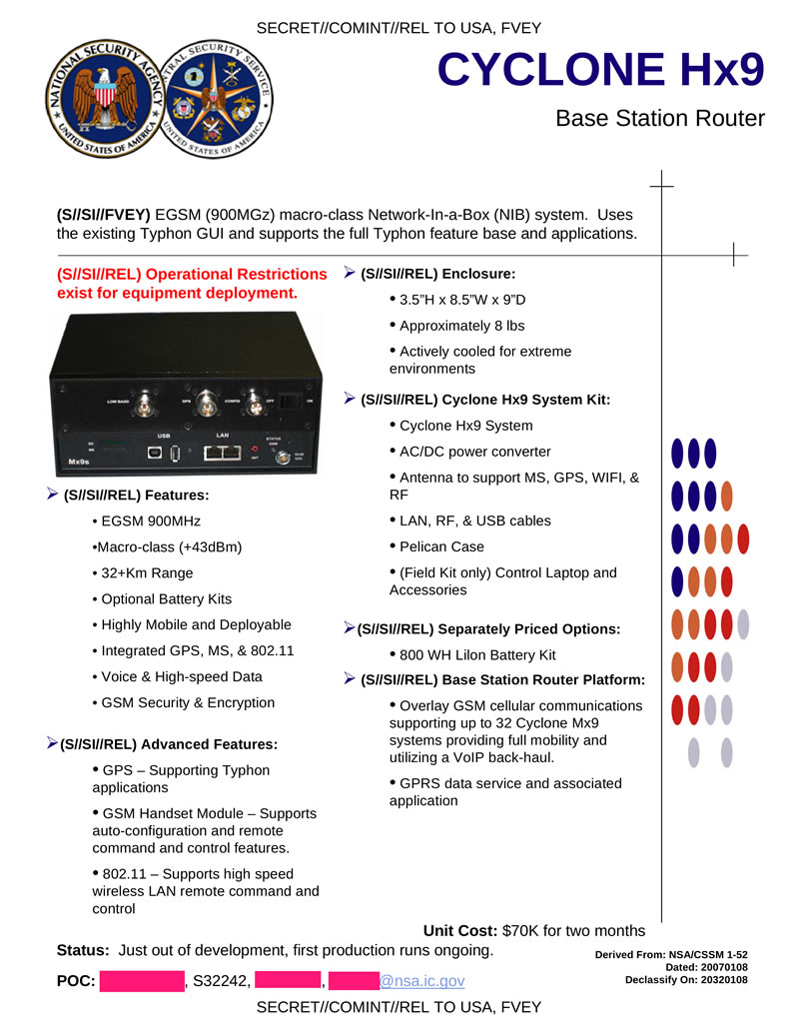

Slide 35
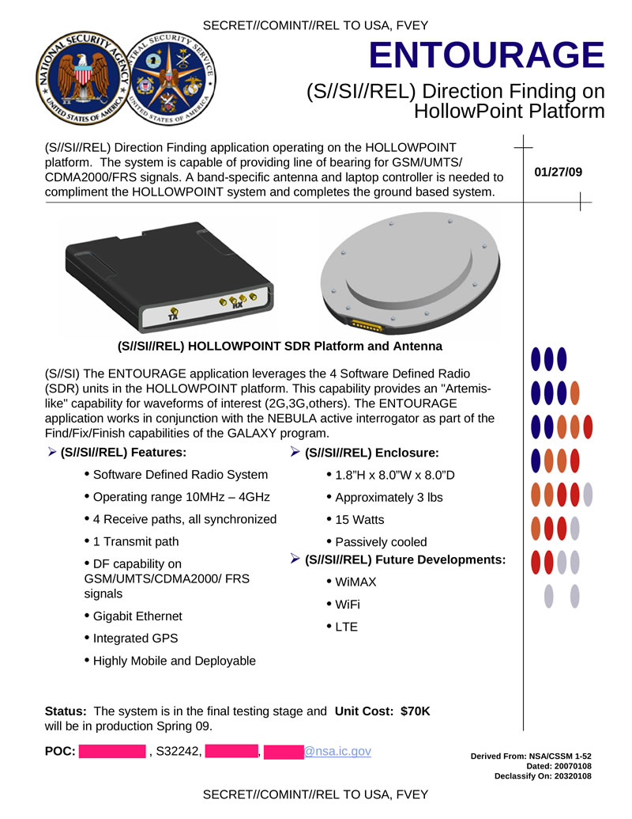

Slide 36
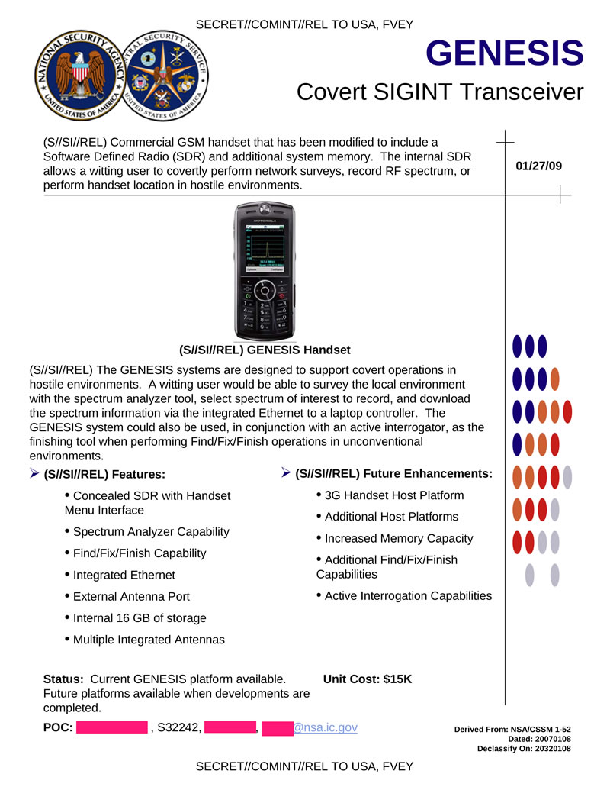

Slide 37
Setting up a GSM ISMI-Catcher
You can create an ISMI Catcher using the GNU Radio GSM module (gr-gsm). ISMI-Catcher is a python script that allows your RTL-SDR to intercept communication between the ME and BTS.
COMMANDS:
pip install PyBOMBS
apt install python-numpy python-scipy python-scapy
pybombs prefix init usr/local -a default_prx
pybombs recipes add gr-recipes git+https://github.com/gnuradio/gr-recipes.git
pybombs recipes add gr-etcetera git+https://github.com/gnuradio/gr-etcetera.git
pybombs install gr-gsm
ldconfig
git clone https://github.com/Oros42/IMSI-catcher.git

Slide 38
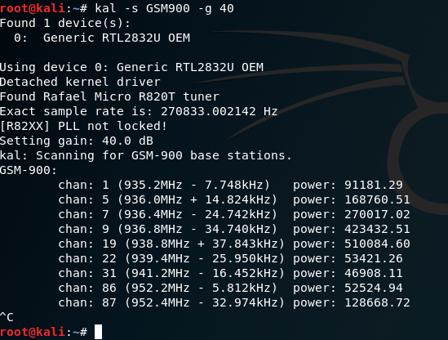
Setting up a GSM ISMI Catcher
Once Everything is set up, you need to tune to an uplink frequency used by GSM in you area. A spectrum analyzer, like GQRX, can be useful in finding these frequencies. However, Gr-GSM does come with a basic one. By installing Kalibrate-RTL, we can easily find GSM base stations. In another terminal, we can run the follow command to help find GSM base stations:
apt-get install kalibrate-rtl
kal -s GSM900 -g 40

Slide 39
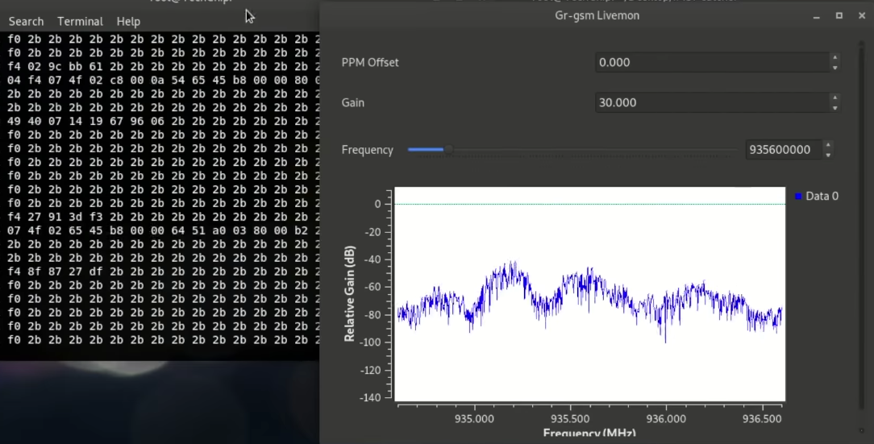
Setting up a GSM ISMI Catcher
In an open terminal, run the command “grgsm_livemon”. This will open a window to where we can change the frequency of our RTL-SDR receiver.
In another terminal, run the ISMI catcher with “./simple_ISMI-catcher.py --sniff”

Slide 40
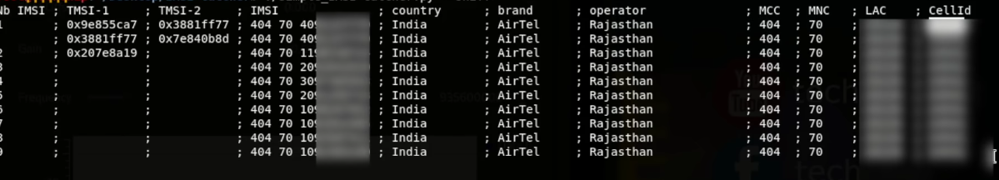
Setting up a GSM ISMI Catcher
Open a new terminal and use sniff with the IMSI catcher.
You will be able to see various cell phone metadata.
LAC = location area, set of base stations that are grouped together to optimize signaling.
CellID = Unique number used to identify each base transceiver station (BTS) or sector of a BTS within a location area code (LAC) if not within a GSM network.

Slide 41
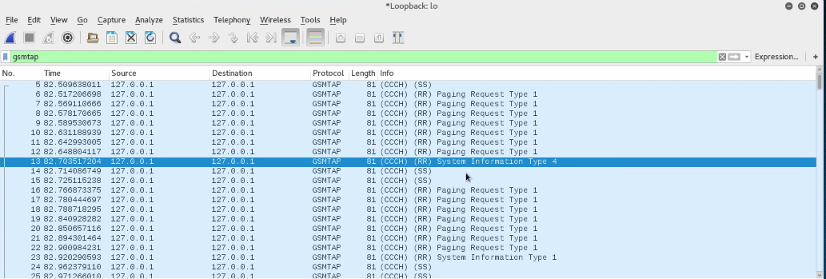
Setting up a GSM ISMI Catcher
Open Wireshark and select the loopback adapter. Then enter “gsmtap” into the filter field.

Slide 42
Decrypting A5/1
To Decode the Encrypted A5/1 communication between the ME and BTS, we need the TMSI (pulled from WireShark) and the Kc (not transmitted). The Kc is not sent over the air. It exist on the SIM card itself, and inside the HLR (which we can’t access).
If you have physical access to the phone, it is possible to extract the Kc using AT commands on Android.
Kraken was created by Frank A Stevenson in 2009, and was usable with the A/51 rainbow tables. Kraken attempts to find the Kc.
https://github.com/joswr1ght/kraken
When the Kc and TMSI are known we can decode it with grgsm_decode. The data will be outputted to the loopback address and viewed in WireShark.

Slide 43
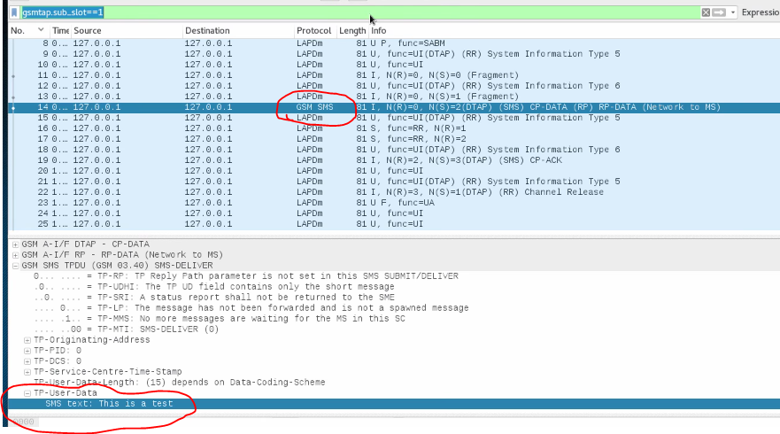
Decrypting A5/1

Slide 44
2G Deprecation (United States)
AT&T – Shutdown January 2017
Verizon – Will shutdown by December 31st 2019
T-Mobile – Postponed shutdown until 2020
Sprint – Committed to support until 2021
Some smaller regional/state providers still support 2G GSM

Slide 45
Useful Videos - References
Crazy Danish Hacker’s GSM Hacking series: https://www.youtube.com/watch?v=3dridHDUHJQ&list=PLRovDyowOn5F_TFotx0n8A79ToZYD2lOv&index=1
DEF CON 23 – LTE and your Laptop: https://www.youtube.com/watch?v=q4pRYZjzL_E
DEF CON 24 – Forcing a Target LTE into an Unsafe Network: https://www.youtube.com/watch?v=Nn8Pwz9MxSA
DEF CON 24 – Discovering and Triangulating Rouge Cell Towers: https://www.youtube.com/watch?v=a6yy5LzQAgw
DEF CON 24 – Attacking BaseStations: https://www.youtube.com/watch?v=m_y7OosNTRc
DEF CON 23 – LTE Recon and Tracking with RTLSDR: https://www.youtube.com/watch?v=ti8_NozsT_I
DEF CON 22 – GSM Sniffing: https://www.youtube.com/watch?v=wzyuioto4y8
DEF CON 21 – Do It Yourself Cellular IDS: https://www.youtube.com/watch?v=OFvPsfJj3Yk
Fantastic Book – From GSM to LTE-Advanced Pro and 5G, 3rd edition by Martin Sauter

